Slide 1
Lecture 16-18
Data Structures
Presented By:
Marina Gul

Slide 2
Topics to be covered
Recap of the previous lecture
Sorting Algorithms and Efficiencies
Types of Sorting
Comparison Sorts
Selection
Selection Sort
Heap Sort
Insertion
Insertion Sort
Shell Sort
Exchange
Bubble Sort
Quick Sort
Merge Sort
Non-comparison sort
Radix Sort

Slide 3
What is sorting
Process with which data are arranged according to their values
Makes identification and finding of data easy
Generic classification
Comparison sort
Non-comparison sort
Two basic categories of sorting algorithms
Internal sorts (data is stored in primary memory)
External sorts (when data cannot fit into primary memory, it is moved to secondary memory for processing)

Slide 4
Some Key Terms
Sort order identifies the sequence of sorted data
Two types: Ascending and Descending Order
Sort efficiency is the measure of relative efficiency of a sort
Sort pass is the traversal of data during sorting
Sort stability indicates that data with equal keys maintain their relative input order in the output

Slide 5
Why is sorting important?
A simple activity with a set of numbers between two students
Student A set: [13,5,17,1,88,4,31,64]
Student B set: [1,4,5,13,17,31,64,88]

Slide 6
Questions
What is the minimum/maximum value in the set?
What is the median value in the set?
Where will a new value 50 be stored?

Slide 7
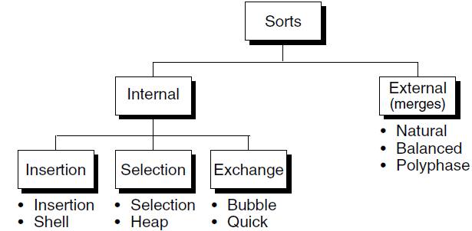
Sort Classification

Slide 8
Bubble Sort
Simplest sorting algorithm
Worst performance among all sorting algorithms
Typically has complexity O(n²)
For a list of N elements, it requires N-1 passes
In each pass, the i^{th} element is compared to (i+1)^{th} element
For ascending order, the smallest element is bubbled from unsorted to sorted list

Slide 9
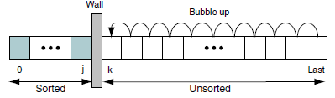
Bubble Sort Concept

Slide 10
Bubble Sort Example
Sorting in Ascending Order using Bubble Sort
Pass # | 23 | 78 | 45 | 8 | 56 | 32
1 | 23 | 45 | 8 | 56 | 32 | 78
2 | 23 | 8 | 45 | 32 | 56 | 78
3 | 8 | 23 | 32 | 45 | 56 | 78
4 | 8 | 23 | 32 | 45 | 56 | 78
5 | 8 | 23 | 32 | 45 | 56 | 78
https://youtu.be/nmhjrI-aW5o

Slide 11
Bubble Sort Efficiency
Bubble sort requires nested loops
Outer loop runs n times, inner loop runs (n+1)/2 times on average
Complexity O(n²)
A simple improvement to naïve bubble sort
include a flag which is raised if there is no exchange
This signifies that the list is already sorted and hence the loop can be prematurely terminated

Slide 12
Insertion Sort
Works similar to how cards are arranged by card players
In each pass, the first element from the unsorted list is inserted into the appropriate place in the sorted list
For n elements, n-1 passes are required

Slide 13
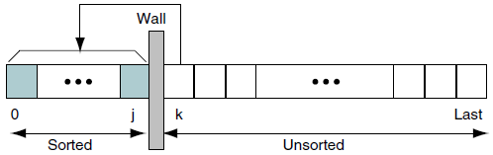
Insertion Sort Concept

Slide 14
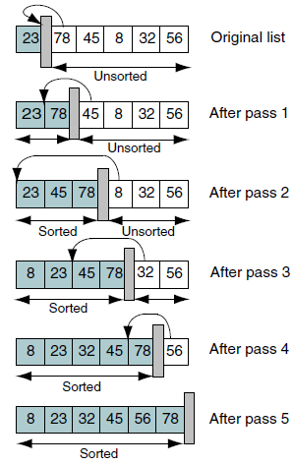
Insertion Sort Example
https://youtu.be/OGzPmgsI-pQ

Slide 15
Insertion Sort Efficiency
The basic insertion sort requires two loops
Hence, the worst case complexity is O(n²)

Slide 16
Selection Sort
The most intuitive of all sorts
Given a list of data to be sorted, we simply select the smallest item and place it in a sorted list
These steps are then repeated until we have sorted all of the data.
Two types of selection sorts
the straight selection sort and
the heap sort

Slide 17
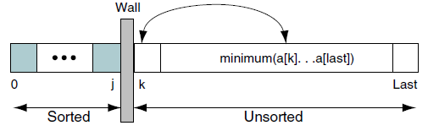
Selection Sort Concept

Slide 18
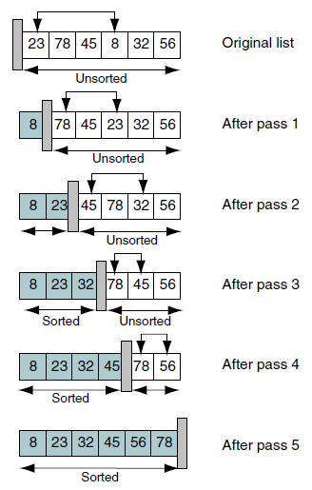
Selection Sort Example
https://youtu.be/xWBP4lzkoyM

Slide 19
Selection Sort Efficiency
The basic selection sort algorithm contains two nested loops
Hence, the worst case complexity is O(n²)

Slide 20
Divide and Conquer
Both merge sort and quick sort employ the divide and conquer design pattern
Three steps
Divide: Split the data into one or more sub-sets until some threshold is met
Conquer: Recursively solve the problem with the subsets
Merge: Take the solutions to the sub-problems and merge them to get the final solution

Slide 21
Divide and Conquer on Merge Sort
Sorting a sequence S with n elements
Step 1: Divide
If S has 0 or 1 element, return S as it is sorted
Otherwise make two sub-sequence S₁ and S₂ such that S₁ contains first floor(n/2) elements and S₂ contains ceil(n/2) remaining elements
Step 2: Conquer
Recursively sort S₁ and S₂
Step 3: Combine
Put back elements into S by merging S₁ and S₂ into a sorted sequence

Slide 22
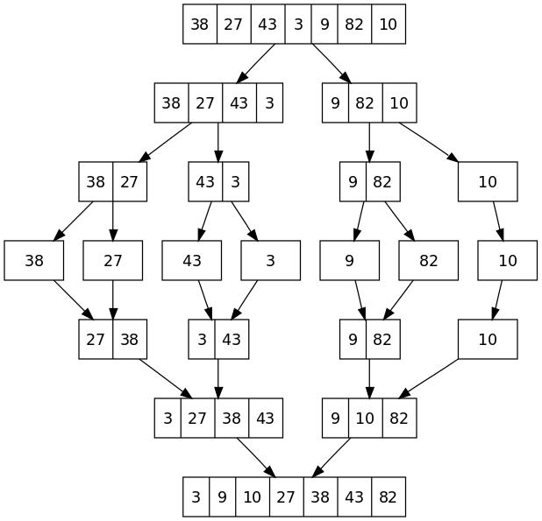
Merge Sort Example
https://youtu.be/JSceec-wEyw

Slide 23
Merge Sort Efficiency
The merge sort algorithm has two parts
Splitting the list into 1 element lists
Merging the sorted 1 element lists into a single sorted list
The first step uses recursion which splits the list into two parts
Complexity: O(log₂n)
The merge step takes at most n iterations to merge all sub-lists
Complexity: O(n)
Time complexity
Best case: O(nlog₂n), Worse Case: O(nlog₂n)
Space complexity
Best case: O(n), Worse Case: O(n)

Slide 24
Quick Sort
Bubble sort exchanges many elements in each pass
Quick sort is efficient as it compares and exchanges elements that are far apart
The total exchanges are reduced to position an element to its correct position
Each iteration quick sort selects a pivot element which splits the list into three parts
Elements that are less than pivot
The pivot element itself
Elements that are greater then pivot
The left and right partitions are then quick sorted recursively
Pivot is usually the median value in the list

Slide 25
Divide and Conquer on Quick Sort
Sorting a sequence S with n elements
Step 1: Divide
If S has 0 or 1 element, return S as it is sorted
Otherwise select one element from S (pivot).
Remove all elements from S and put them in 3 sequences
L: containing all elements less than pivot
E: containing all elements equal to pivot
G: containing all elements greater than pivot
Step 2: Conquer
Recursively sort sequences L and G
Step 3: Combine
Put back elements into S in order by first taking elements from set L then E and finally G

Slide 26
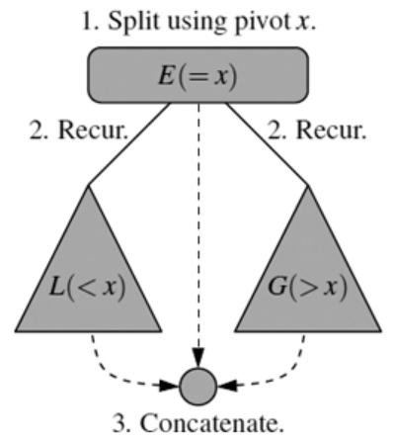
Quick Sort Visualization

Slide 27
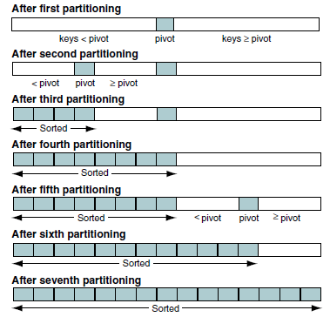
Quick Sort Concept

Slide 28
Quick Sort Example
10 | 16 | 8 | 12 | 15 | 6 | 3 | 9 | 5
10 | 5 | 8 | 12 | 15 | 6 | 3 | 9 | 16
10 | 5 | 8 | 9 | 15 | 6 | 3 | 12 | 16
10 | 5 | 8 | 9 | 3 | 6 | 15 | 12 | 16
6 | 5 | 8 | 9 | 3 | 10 | 15 | 12 | 16
https://youtu.be/WprjBK0p6rw
https://youtu.be/PgBzjlCcFvc

Slide 29
Quick Sort Example
6 | 5 | 8 | 9 | 3 | 10 | 15 | 12 | 16
6 | 5 | 8 | 9 | 3 | 10 | 15 | 12 | 16
6 | 5 | 3 | 9 | 8 | 10 | 15 | 12 | 16
3 | 5 | 6 | 9 | 8 | 10 | 15 | 12 | 16
3 | 5 | 6 | 8 | 9 | 10 | 15 | 12 | 16
3 | 5 | 6 | 8 | 9 | 10 | 15 | 12 | 16

Slide 30
Quick Sort Example
3 | 5 | 6 | 8 | 9 | 10 | 15 | 12 | 16
3 | 5 | 6 | 8 | 9 | 10 | 12 | 15 | 16
3 | 5 | 6 | 8 | 9 | 10 | 12 | 15 | 16
3 | 5 | 6 | 8 | 9 | 10 | 12 | 15 | 16

Slide 31
Quick Sort Efficiency
The partitioning loop runs n times
Complexity: O(n)
The two recursions process portion of the array
Complexity: O(log₂n)
Time Complexity:
Best case: O(nlog₂n), Worse Case: O(n²)
Space Complexity:
Best case: O(log₂n), Worse Case: O(n)

Slide 32
Recap of the Lecture
Different sorting algorithm has been discussed.

